Slide 1
Moderated Panel: State of Minibulk Recycling Programs
We did not have a “state-based” minibulk recycling program in 2012. Why not?
For companies that are not recycling minbulks/IBCs, what are the main obstacles?
What is the best way to leverage everyone’s resources to recycle as many minibulks/IBCs as possible?

Slide 2
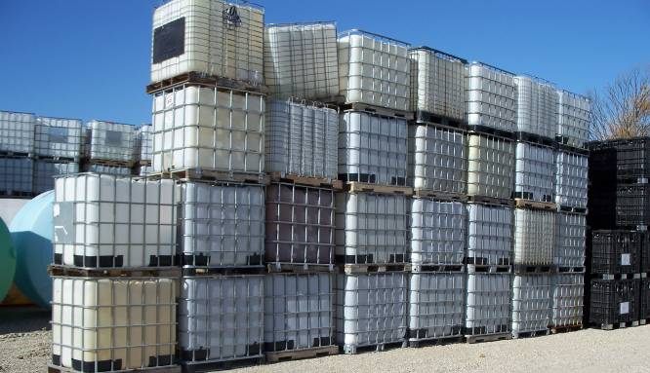
$$$$$ ?
Rinsing or managing containers?
Pesticide Users, Retailers & Distributors
?
Reconditioners and Recyclers: want containers
Lack of awareness?
Liability?
Other?

Slide 3
Notes:
As the Pesticide Industry representative currently serving on TPSA’s BOD, I would like to stress the importance of Mini Bulk/IBC selection, design, and management.
The US pesticide registrant community fully supports the development and communication of industry standards and best practices which increase the stewardship of pesticide products.
TPSA provides a unique venue for industry, academic, research, and governmental agency collaboration to address pesticide stewardship challenges.

Slide 4
Antitrust & Fair Trade Statement
While most activities among competitors in the same industry are both legal and beneficial to the industry, group activities of competitors are inherently suspect under the antitrust laws. Agreements or combinations between or among competitors need not be formal to raise questions under antitrust laws, but may include any kind of understanding, formal or informal, secretive or public, under which each of the parties can reasonably expect that another will follow a particular course of action.
Each individual is responsible to see that topics which may give an appearance of an agreement that would violate the antitrust laws are not discussed at your meetings. It is the responsibility of each individual in the first instance to avoid raising improper subjects for discussion. This reminder has been prepared to assure that individuals in meetings are aware of this obligation.
Each party and every individual at every meeting related thereto should be thoroughly familiar with his/her responsibilities under the antitrust laws and should consult counsel in all cases involving specific situations, interpretations, or advice as per TPSA Policy 17.0 Anti-Trust & Fair Trade Guidelines. Thank you for your attention to this statement.

Slide 5
Panelists
Scott Birchfield, Syngenta Crop Protection, LLC
Linda Hendrickson, Crop Production Services, Inc.
Gary Glickman, Container Services Network, LLC
Mike Harding, IBC North America & Clean Tide Container
Brian Bilyeu, Cropland Containers
Derrick Bell, North Carolina Department of Agriculture and Consumer Services

